Slide 1


Employment by Sector Forecast
Presenter: Divendra Raj
Date:
15/04/2023

Slide 2
Agenda
Introduction
Business Background
Business Objective
Data Pipeline
Data Summary
Data Wrangling and Analysis
Building Model and outcome
Model Testing and Interpretation
Next Step and conclusion

Slide 3

Business Background
Government, some relevant business/companies, and some career building employee relay on how individual sector is performing like Primary Industry, Manufacturing Industry and Financial sector.
They are involved in either investment or diverting their career to earn more money.
The movement of workers can be a huge impact on the industry as whole. Some sectors can really struggle to find workers as some would be overwhelmed. Recently government are opening boards to bring in workers from overseas to meet the demand for workers in various sector.
If these predictions are done in time than it could have prevented lots of problems, and even start planning to face the challenges by either allocating or diverting more funds in the sector to resolve the issue. Also, for the business to avoid where they will struggle to find workers and save from potential losses.
In New Zealand employment rate is 69.30 percent (2.85 million) and unemployment rate is 3.40 percent (over 90,000) as of Dec 2022. (Sourced from Stats New Zealand)
The government can save millions of dollars if they can engage unemployed people to such areas instead of just paying social benefit if any cannot find suitable jobs. Business would save millions of dollars investing in training where workers are scarce.
3

Slide 4
Business Objective
The main objective is to minimise unemployment and engage people in employment than being on benefits and prepare ahead of unforeseen circumstances.
Business Question
In this occasion, stats New Zealand collects data and using the data if I can build a precise model that can forecast movement of workers for the different business sectors and save millions of dollars.
Importing Data – Stats New Zealand
Exploratory data Analysis
Data Pre-processing
Building Time Series Analysis Model – using ARIMA
Testing/Results
Next Step/ Conclusion
Data Pipeline
4

Slide 5
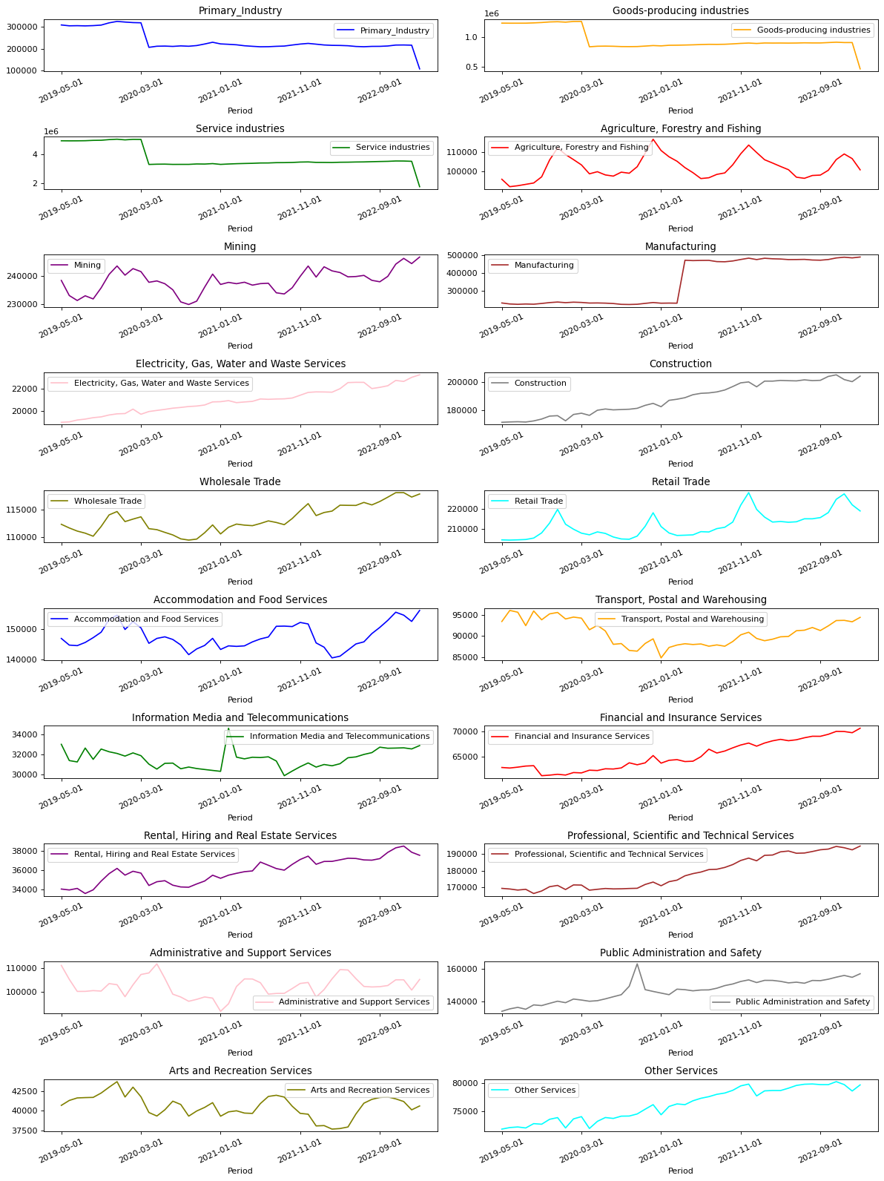
Data Summary
The dataset downloaded from Stats New Zealand. All kinds of datasets are publicly available.
The dataset downloaded csv format contained current employment figures from 1999 to Feb 2023 based on Sector, Age, Region, type and Sex.
However, I used employment by sector dataset from 2019 to 2023 to build my Time Series Analysis for forecasting.
The numbers were on monthly basis hence only 46 lines of data
Exploratory Data Analysis
The dataset was very clean and did not contain any null values but since all the data were compiled together data extraction was bit of challenge.
Finally, got a nice line graph which explains the performance of each sector. From the analysis we can see first 4 sectors employment numbers is falling at a high rate when compared with others.
Of course, that can be an alarming but let’s build a model to find out.
5

Slide 6
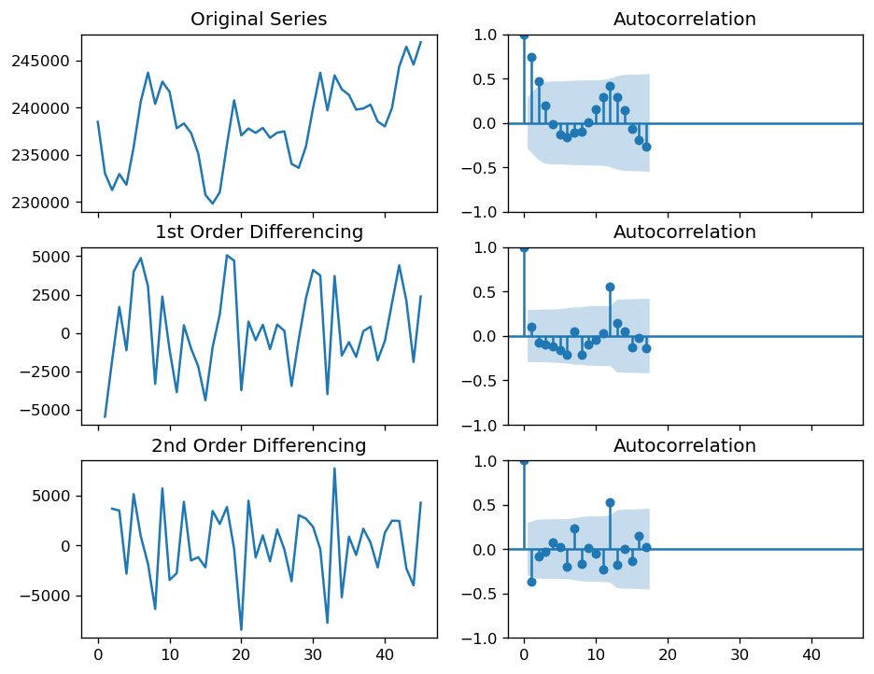
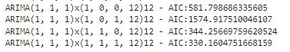
Building Model
Checking the stationarity of the data
New Zealand has 4 different seasons so building a Times Series Model using ARIMA/SARIMA would be the best option to see if season has any effect.
Randomly used Mining sector data which has minor effect of seasons.
First, I checked the stationary of the data using adfuller. The result was not great, the p value was great than 0.05 hence the data was not stationary
ADF Statistic: %f : -1.7815040802192887
p-value: %f : 0.3896822937055069
#lags Used : 0
Number of Observation Used : 45 Weak evidence, indicating it is non-stationary
To stationary the data I use the order of differencing tactic and the outcome was what I was looking for. First order of differencing did the work.
Finding p, d and q
After finding p, d, q which was (1,1,1) I was ready to build the ARIMA model.
6

Slide 7
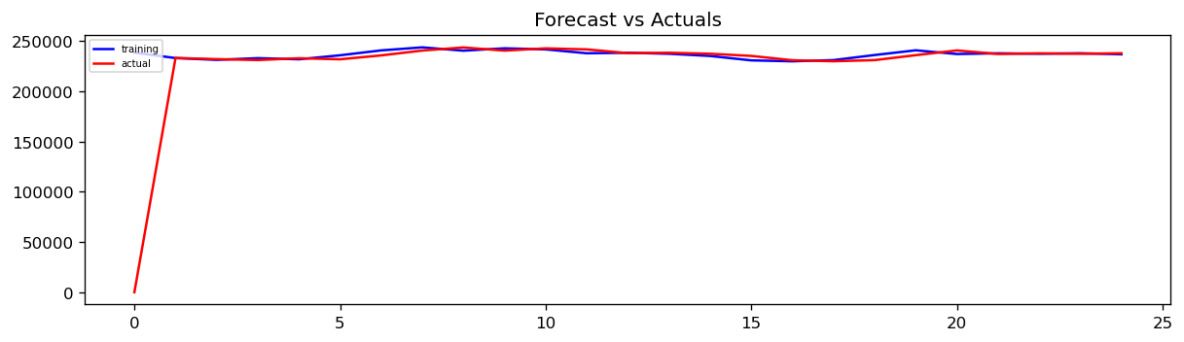
Building Model
SARIMAX Results
===================================================================
Dep. Variable: y No. Observations: 25
Model: ARIMA(1, 1, 1) Log Likelihood -224.065
Date: Thu, 13 Apr 2023 AIC 454.130
Time: 23:14:17 BIC 457.664
Sample: 0 HQIC 455.067
- 25
Covariance Type: opg
===================================================================
coef std err z P>|z| [0.025 0.975]
------------------------------------------------------------------------------------------------------------------------------------
ar.L1 0.1994 1.784 0.112 0.911 -3.297 3.695
ma.L1 -0.2247 1.685 -0.133 0.894 -3.527 3.078
sigma2 8.298e+06 4.99e-07 1.66e+13 0.000 8.3e+06 8.3e+06
====================================================================
Ljung-Box (L1) (Q): 0.98 Jarque-Bera (JB): 0.85
Prob(Q): 0.32 Prob(JB): 0.65
Heteroskedasticity (H): 0.99 Skew: 0.26
Prob(H) (two-sided): 0.98 Kurtosis: 2.23
===================================================================
Model Result and Interpretation
The model was built on a training dataset 25 months and the result was great.
Plotting on a line graph
The actuals were plotted vs the forecast. The result was positive and can the goal be achieved
7

Slide 8
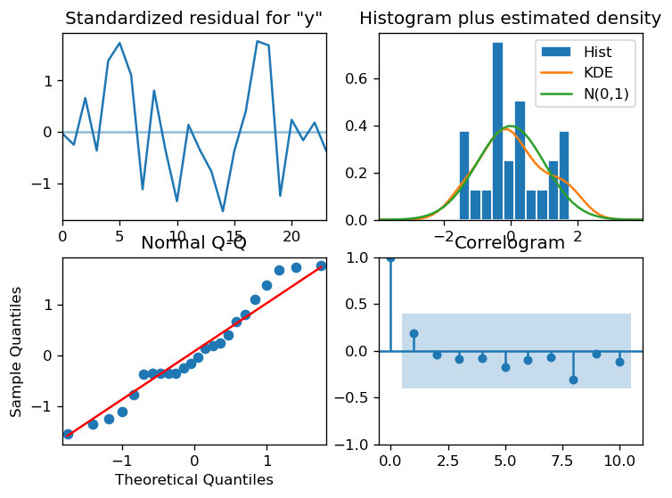
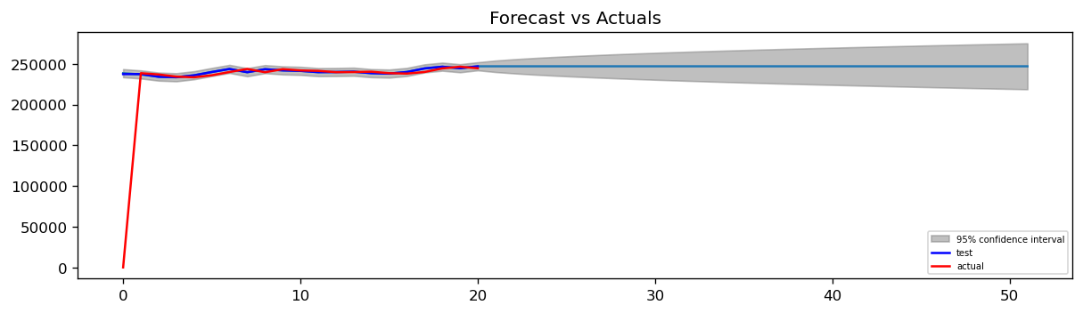
Model Result
Model Review
Top left: The residual errors seem to fluctuate around a mean of zero and have a uniform variance.
Top Right: The density plot suggest normal distribution with mean zero.
Bottom left: All the dots should fall perfectly in line with the red line. Any significant deviations would imply the distribution is skewed.
Bottom Right: The Correlogram, aka, ACF plot shows the residual errors are not autocorrelated. Any autocorrelation would imply that there is some pattern in the residual errors which are not explained in the model. So, you will need to look for more X’s (predictors) to the model.
Overall, it seems to be a good fit. Let’s forecast.
Model Forcast
Prediction was done for next 6 months and the model did a nice forecast.
8

Slide 9

Next Step Despite satisfying model performance there are other tools which can be used to see if better model can be build.
Conclusion Time Series Analysis are widely used worldwide and has been a great help in solving lots of problems. It is also good for my career as with my financial background understanding data and company requirement can be achieved easily.
Reference - Stats New Zealand
- Authors: Prabhanshu Attri, Yashika Sharma, Kristi Takach, Falak Shah
https://colab.research.google.com/github/keras-team/keras-io/blob/master/examples/timeseries/ipynb/timeseries_weather_forecasting.ipynb#scrollTo=aAOKbLOf7M1_
- Selva Prabhakaran
https://www.machinelearningplus.com/time-series/arima-model-time-series-forecasting-python
- Anandhu H
https://www.kaggle.com/code/anandhuh/time-series-analysis-covid19-cases-arima-model
And thanks to Amin/ Rick/ Sebastian
9

Slide 10




Thank you
Divendra Chand Raj
divenraj7@gmail.com

